Slide 1


Application Area of Big Data
Associate Professor
Department of Computer Science and Engineering

Slide 2
Session Objectives
Core Application area of Big Data

Slide 3
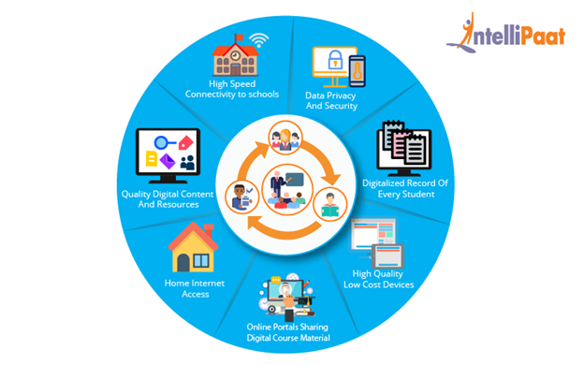
Education Industry

Slide 4
Education Industry
Customized and dynamic learning programs:
Customized programs and schemes for each individual.
Created using the data collected on the bases of a student’s learning history to benefit all students.
Reframing course material:
Reframing the course material according to the feedback.
Real time monitoring of what components of a course are easier and difficult to understand.
Grading Systems:
New advancements in grading systems have been introduced as a result of proper analysis of student data.
Contd…

Slide 5
Education Industry
Career prediction:
Proper analysis and study of every student’s records will help in understanding the student’s progress.
To know their strengths, weaknesses, interests and more.
It will help in determining which career would be most appropriate for the student in the future.

Slide 6
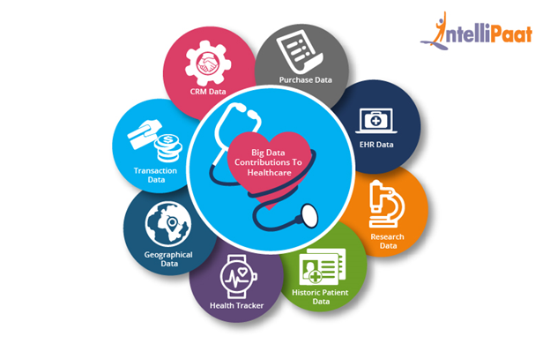
Healthcare Industry

Slide 7
Healthcare Industry
Big data reduces costs of treatment since there is less chances of having to perform unnecessary diagnosis.
It helps in predicting outbreaks of epidemics and also helps in deciding what preventive measures could be taken to minimize the effects of the same.
It helps avoid preventable diseases by detecting diseases in early stages and prevents it from getting any worse.
Patients can be provided evidence based medicine which is identified and prescribed based on past medical results.
Example:
Wearable devices and sensors have been introduced in healthcare industry which can provide real time feed to the electronic health record of a Patient.

Slide 8
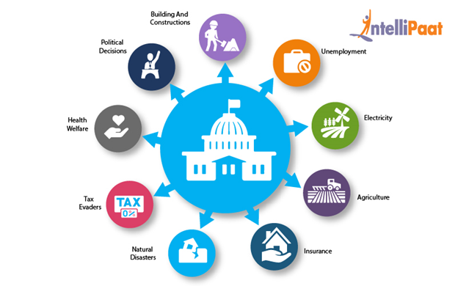
Government Industry

Slide 9
Government Industry
Welfare schemes:
In making faster and informed decisions regarding various political programs.
To indentify the areas that are in immediate need of attention.
To stay up-to-date in the field of agriculture by keeping track of all the land and livestock that exists.
To overcome national challenges such as unemployment, terrorism, energy resource exploration and more.
Cyber security:
Big Data is hugely used for deceit recognition.
Governments are also finding the use of big data in catching tax evaders.

Slide 10

Media and Entertainment industry

Slide 11
Media and Entertainment industry
Some of the benefits extracted from the big data in media and entertainment industry:
Predicting the interests of audiences.
Optimized or on-demand scheduling of media streams in digital media distribution platforms.
Getting Insights into customer’s reviews and pinpointing their animosities.
Effective targeting of the advertisements for media

Slide 12
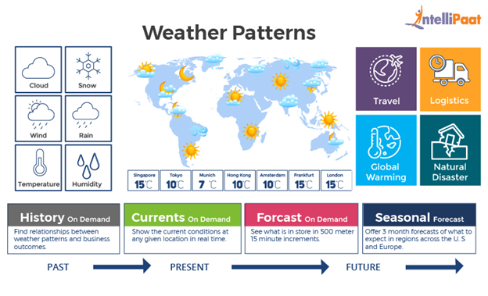
Weather Patterns

Slide 13
Weather Patterns
The data collected from sensors and satellites contributes to big data and can be used in different ways such as:
In weather forecast
To study global warming
Understanding the patterns of natural disasters
To make necessary preparations in case of crisis
To predict the availability of usable water around the world.
Example:
IBM deep thunder which is a research project by IBM, provides weather forecasting through high performance computing of big data. IBM is also assisting Tokyo with the improved weather forecasting for natural disasters or probability of damaged power lines in order to plan successful 2020 Olympics.

Slide 14
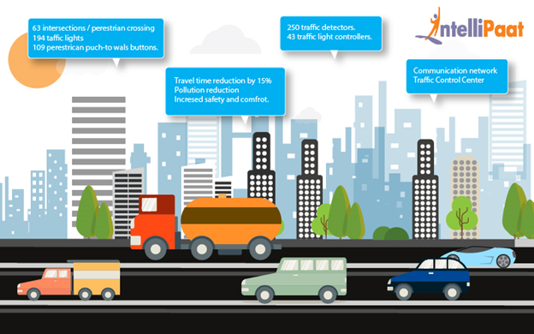
Transportation Industry

Slide 15
Transportation Industry
Route planning: Big data can be used to understand and estimate the user’s needs on different routes and on multiple modes of transportation and then utilizing route planning to reduce the users wait times.
Congestion management and traffic control: Using big data, real time estimation of congestion and traffic patterns is now possible. Example: Google Maps.
Safety level of traffic: Using the real time processing of big data and predictive analysis to identify the traffic accidents prone areas can help reduce accidents.
Example
Uber generates and uses a huge amount of data regarding drivers, their vehicles, locations, every trip etc. It is analyzed and used to predict the supply, demand, location of the drivers and the fares that will be set for every trip.

Slide 16
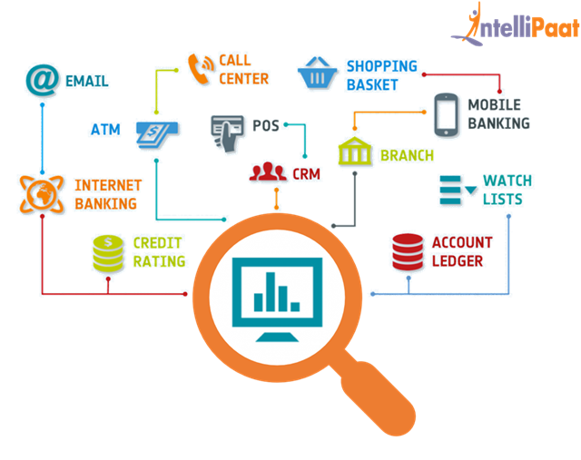
Banking Sector

Slide 17
Banking Sector
The misuse of credit cards
Misuse of debit cards
Venture credit hazard treatment
Business clarity
Customer statistics alteration
Money laundering
Risk Mitigation

Slide 18
1. Discussed the core application area of Big Data
Summary

Slide 19
Thanks

